Slide 1

Mastering Excel VBA & Macros
School of Automation

Slide 2
Introduction
What is VBA?
VBA stands for ‘Visual Basic for Applications’
VBA is an implementation of Microsoft's event-driven programming language Visual Basic 6 and VBA continues to be one of the most popular tool for automating repetitive tasks using Microsoft Office suite of programs
VBA is built into most Microsoft Office applications including Microsoft Excel, Access and Outlook and the language was designed to be intuitive for users who are familiar with the Microsoft Office applications. For example, in Excel VBA, a line of code Range("A1").AddComment("Hello") instructs Excel to add a comment “Hello” in a cell “A1”
Who is this course for?
This course assumes no prior knowledge of VBA and this course is for those of you, where:
You may be already familiar with Microsoft Excel and may have recorded few macros previously but want to learn to write VBA macros from scratch
You want to learn the fundamentals of VBA programming language and gain ability to apply VBA to real life problems
You have tedious and repetitive tasks that you’d like to automate
You would like to make your spreadsheets into more user friendly with user interactions such as buttons, message boxes, etc

Slide 3
Introduction
Course Objectives
By the end of this course, you will:
Know your way around the VBA development environment (Developer tab, VBA editor)
Know how to write VBA Sub-routines and Functions from scratch
Gain firm understanding of VBA programming language syntax such as IF, For Loop, Do Loop, Arrays by going through 45+ real life VBA example/exercise codes in the Examples workbook
Know how to automate tedious and repetitive tasks and processes in Excel
Know how to make your spreadsheets more interactive by using message box, input box and buttons

Slide 4
Curriculum
Getting Started
Showing the 'Developer' tab
Finding your way around the VBA editor environment
Your first VBA program
Looking closer at your first VBA program
Modules
Sub-routines
Comments
Variables and declarations
Operators
Variable Scope
Learn by doing: VBA fundamentals with example programs
Some useful built-in functions used throughout this course
Mastering Excel ‘objects’ by:
Mastering Cell Range
Mastering Worksheet
Mastering Workbook
More sophisticated programming with:
Functions
IF statements
For loops and Do loops
Arrays
Debugging VBA programs
Error handling: On Error GoTo statement
User Interaction
Message boxes and Input boxes
Programming a Button

Slide 5
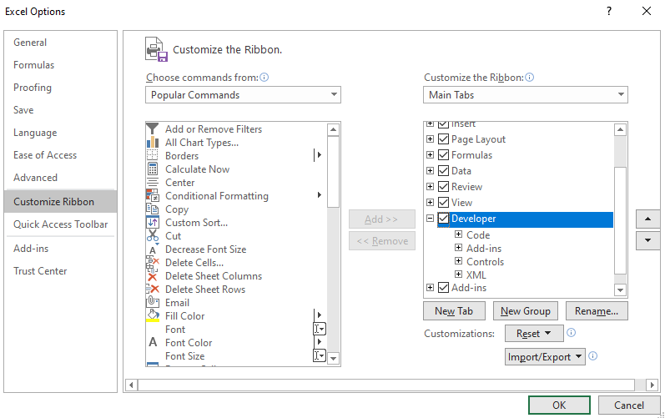
Getting Started – Developer Tab
How to show the ‘Developer’ tab
The Developer tab has necessary tools, where you can write macros, run macros that you previously recorded, add some user interactivity to your spreadsheet such as buttons, checkboxes, etc:
Go to File > Options
Select Customize Ribbon
Under the Main Tabs, select the Developer checkbox and then choose OK

Slide 6
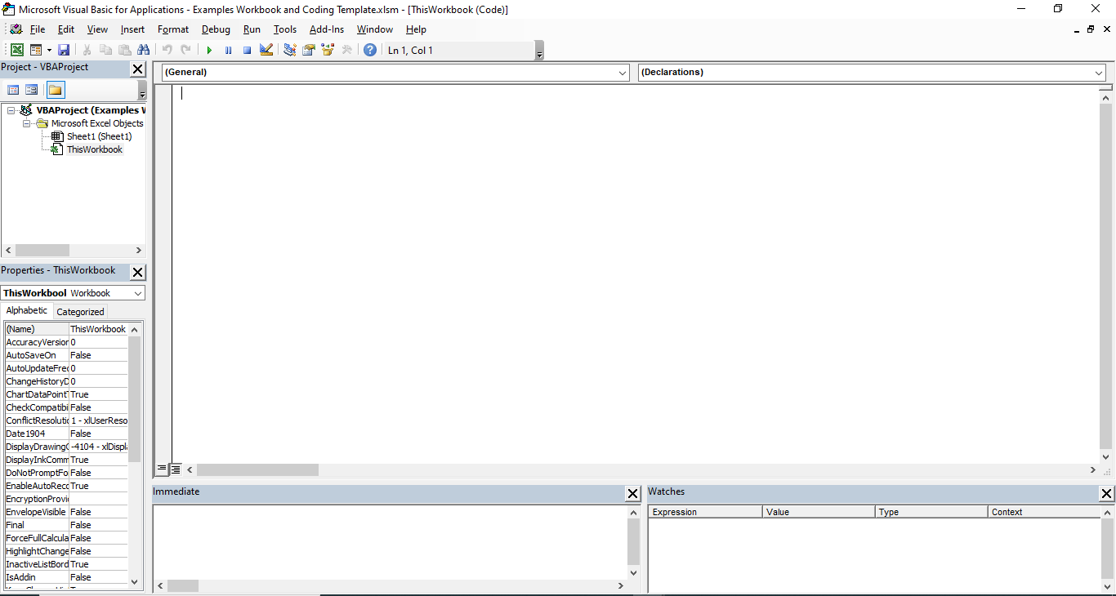
Getting Started – VBA editor
How to show the VBA editor
The VBA editor is where you write your VBA program or view previously recorded macros. You can also design your own User forms which can enhance user experience for your spreadsheet application. To show the VBA editor:
On the Developer tab, click Visual Basic
Project Explorer
Where you write VBA code
Properties Window
Immediate Window
Watch Window

Slide 7
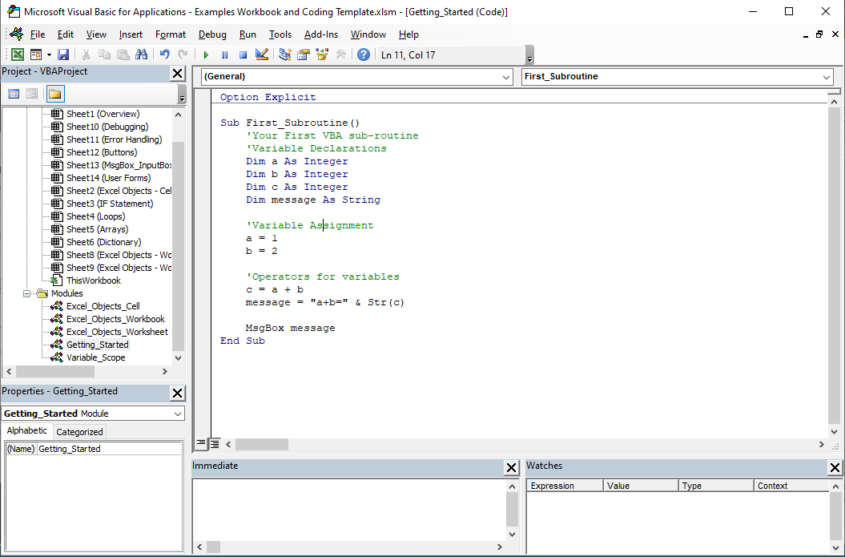
Getting Started – Your First VBA Program
Run your first
VBA program
Open the Example workbook
Show ‘Developer’ tab if you haven’t done so per the previous slides
Show VBA editor
Double click on the ‘Getting Started’ module – Do not worry about what the program does yet!
Click on the button to run the program

Slide 8
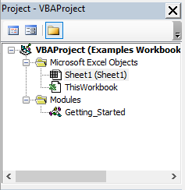
Getting Started – Looking Closer At Your First VBA Program
Module
In an Excel VBA project for a given Excel macro-enabled workbook (*.xlsm), you can either write your VBA code in “placeholders” within the ‘ThisWorkbook’ object, a Worksheet object or a Module.
You can think of Modules as placeholders, where you can write VBA code, which is accessible by any part of the Excel application the module belongs to. In the example VBA program we have created, a module called ‘Getting_Started’ has been added to the workbook by going to VBA Editor > Project window > Right click on the ‘VBAProject’ > Insert > Module.
VBA code written in the Module
Module ‘Getting_Started’

Slide 9
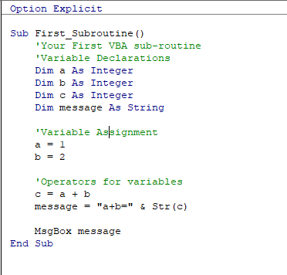
Getting Started – Looking Closer At Your First VBA Program
Sub-routines
A Sub-routine is a piece of code that performs a specific task and does NOT return a result. Sub-routines are used to break down large pieces code into small manageable parts, which can be called repeatedly.
Beginning of a Sub-routine
Code that gets run when the Sub-routine gets executed
End of a Sub-routine

Slide 10

Getting Started – Looking Closer At Your First VBA Program
Comments
Here is what you see in the first section of the subroutine ‘First_Subroutine()’ . The apostrophe character/symbol ‘ at the beginning signify a single-line comment in excel VBA.
Comments are written in plain English to provide an explanation or comment on the code. All comments written after an apostrophe symbol (per above) are completely ignored by Excel when the VBA program is being executed. Writing succinct and well explained comments on what a specific piece of code does is a best practice shared among many programmers, as this helps one to understand how the code works, especially as one begins to write large complex programs.

Slide 11


Getting Started – Looking Closer At Your First VBA Program
Variables and Declarations
Variables are used in VBA to store values for later use in the program
It is a best practice to declare variables before usage within the program and declaration of a variable involves specifying its name and characteristics (e.g. data type, scope of the variable). Typing the ‘Option Explicit’ command at the very beginning of every module enforces declaration of variables.
In our first example VBA program, 5 variables have been declared per below. The basic syntax for declaring a variable is Dim <<variable name goes here…>> As <<variable data type goes here…>>
There are many variable data types and I will not be listing them all here but common examples, which will be used in this course include the following.
String: text variable e.g. “hello world”
Integer: an integer (whole number) variable with a range from -32,768 to 32,767
Long: an integer variable with a range from -2,147,483,648 to 2,147,483,647
Double: a decimal numerical variable
Boolean: a variable holding True or False values
Excel objects such as Range, Worksheet, Workbook
Arrays
Variable assignments means storing some value in the variable declared. In our example code, below are examples of storing numerical values in the variables a and b.

Slide 12

Getting Started – Looking Closer At Your First VBA Program
Operators
‘Operators’ can be used with variables as ‘operands’ to compute a relevant result. For example, in our example program, we have used an arithmetic operator ‘+’ to add two numerical variables a and b. We also have used a concatenation operator ‘&’ to concatenate two strings “a+b=“ and the results of adding a and b converted to a String using the Str() function.
There are four different types of commonly used ‘operators’ in VBA. We will only cover the most commonly used operators here but there are many resources on the web which provides a full list of operators in VBA.
Type | Operator | What does it do?
Arithmetic Operator | + | Adds the two operands (e.g. 1 + 2 returns 3)
 | - | Subtracts the second operand from the first one
 | * | Multiplies both the operands
 | / | Divides the numerator by the denominator
 | Mod | Returns the remainder of a division operation (e.g. 3 Mod 2 = 1, 5 Mod 3 = 2)
Comparison Operator | = | Returns True if two operands are the same (e.g. 1 = 1 is True)
 | <> | Returns True if two operands are NOT the same (e.g. 1 <> 2 is True)
 | > | Returns True if the first operand is greater than the second (e.g. 2 > 1 is True)
 | < | Returns True if the first operand is less than the second
 | >= | Returns True if the first operand is greater than or equal to the second
 | <= | Returns True if the first operand is less than or equal to the second
Boolean/Logical Operator | AND | Returns True if both the conditions are True (e.g. (2>1) AND (3>2) is True)
 | OR | Returns True if any of the two conditions are True (e.g. (2>1) OR (1>2) is True)
 | NOT | Returns the reverse of the condition (e.g. NOT True is False and NOT False is True)
Concatenation Operator | & | Concatenates two String operands (e.g. “hello” & “world” returns “helloworld”)

Slide 13
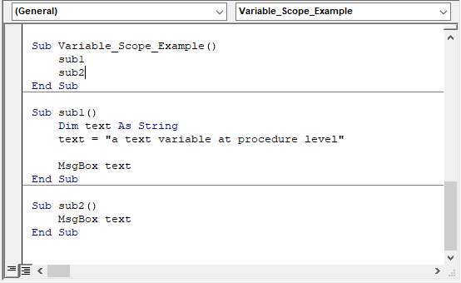
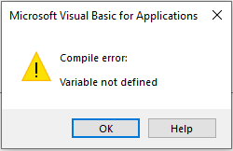
Getting Started – Looking Closer At Your First VBA Program
Variable Scope
The scope of a variable in Excel VBA determines where that variable may be used. You determine the scope of a variable when you declare it. There are three scoping levels:
Procedure level: This means that a variable can only be used within a Sub-routine or a Function but not outside it. For example, see below two Sub-routines sub1 and sub2 both using a variable called ‘text’ but the ‘text’ variable is only declared inside sub1.
If you run this code, sub1 will run successfully as ‘text’ is declared inside it but sub2 will give the following error:
Module level
Public module level.

Slide 14
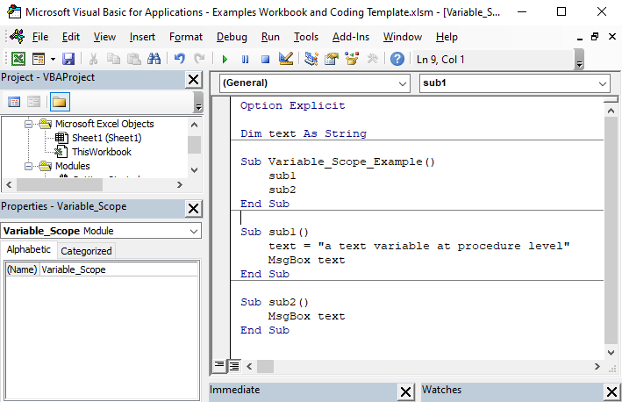
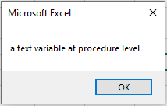
Getting Started – Looking Closer At Your First VBA Program
Variable Scope
Module level: In the previous example code, if you want a variable to be available to all procedures in a module, this means that the variable needs to have module level scope. In order to do this, the variable in question must be declared at the beginning of the module outside all Sub-routines or Functions in the module per below.
Running the above code, will successfully prompt two separate messageboxes from both Sub-routines, sub1 and sub2 as the text variable is declared at module level and can be used by both sub1 and sub2.

Slide 15
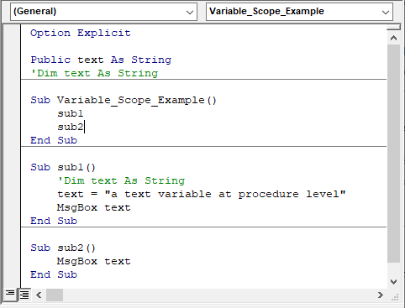
Getting Started – Looking Closer At Your First VBA Program
Variable Scope
Public module level (or Global level): If you have multiple modules in a workbook and you’d like your variable to be available to all Sub-routines and Functions in all modules in the workbook, you can declare your variable using the ‘Public’ keyword per the below screenshot: Public <<variable name goes here…>> As <<variable data type goes here…>>

Slide 16





Learning by Doing: VBA Fundamentals
Some useful built-in functions for this course
Below is a list of some useful built-in Excel functions, which we can use in our VBA programs throughout this course. These functions are for manipulating String values (i.e. text).
LEFT(text_string, number_of_characters): returns the specified number of characters in a text string, starting from the first or left-most character. For example, in the ‘Immediate Window’, typing Left(“abcde”,4) will return the left 4 characters of “abcde” per below screenshot.
RIGHT(text_string, number_of_characters): returns the specified number of characters in a text string, starting from the last or right-most character. For example, in the ‘Immediate Window’, typing Right(“abcde”,4) will return the right 4 characters of “abcde” per below screenshot.
MID(text_string, start_character_number, number_of_characters): returns the specified number of characters in a text string, starting from a specified position (i.e. start_character_number). For example, Mid(“abcde”,2,3) returns 3 characters starting from a character position 2 within “abcde” per below screenshot.
LEN(text_string): returns the number of characters in a given string (i.e. text_string). For example, Len(“abcde”) will return 5 per below screenshot.
InStr(start_character_number, text_string1, text_string2): returns the character position of the first occurrence (from left to right) of text_string2 within text_string1. The ‘start_character’ parameter specifies the position (i.e. character number) within string from where you want to start your search for the substring. E.g. “bc” is found in character position 2 of the string “abcde”

Slide 17
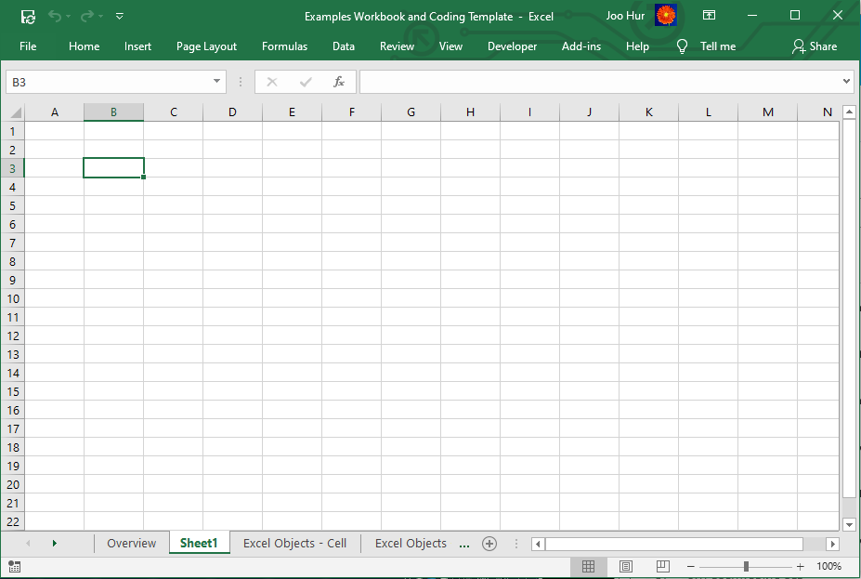
Learning by Doing: VBA Fundamentals
Excel ‘Objects’
Excel ‘Objects’ refer to the ‘Excel Object Model’, which are essentially the building blocks that make up an Excel workbook, such as worksheets, rows, columns, cell ranges and of course the Excel workbook itself.
Using VBA, we can access these objects and change ‘properties’ of these objects such as cell range’s value, colour, worksheet’s name and many others including charts, pivot tables, etc. This gives VBA programmers power to automate a lot of tasks in Excel.
In the Example workbook’s ‘Excel Object’ worksheet, we will go through examples and exercises for the following Excel Objects:
Workbook
Cell Range
Variable assignments for Objects use Set keyword. For example:
Dim wb As Workbook
Set wb = ThisWorkbook
Dim ws As Worksheet
Set ws = ActiveWorksheet
Dim cell As Range
Set cell = Range(“A1”)
Worksheet

Slide 18
Learning by Doing: VBA Fundamentals
Recap: Sub-routines
A Sub-routine is a piece of code that performs a specific task and does NOT return a result. Sub-routines are used to break down large pieces code into small manageable parts, which can be called repeatedly.
[Public | Private] Sub name [ ( arg_list ) ] [Code goes here…] End Sub
Beginning of a Sub-routine
Code that gets run when the Sub-routine gets executed
End of a Sub-routine

Slide 19

Learning by Doing: VBA Fundamentals
Functions/Methods
A Function or Method is a piece of code that performs a specific task and in that sense is very similar to a Sub-routine. The key difference between a Function/Method and a Sub-routine is that, Function/Method returns an output (e.g. a value or a collection of values) whereas a Sub-routine does not return anything. A Function/Method is used to break down large pieces code into small manageable parts, which can be called repeatedly.
A function/method follows the below syntax in VBA:
For example, please see below a function, which adds two input variables and returns the sum. Running ‘Add_Nums(1,2)’ in the Immediate Window will return 3.
[Public | Private] Function name [ ( arg_list ) ] [ As type ] [Code goes here…]
[name = expression] End Function
The output is an integer
This function can be called “publicly” both inside and outside the model. If Private used instead, the function can only be called inside the module
The output is calculated by
a + b
The input for the function are a and b which are both Integers
ByVal means input parameters are passed in “by value”
ByRef means input parameters are passed in by “reference”

Slide 20
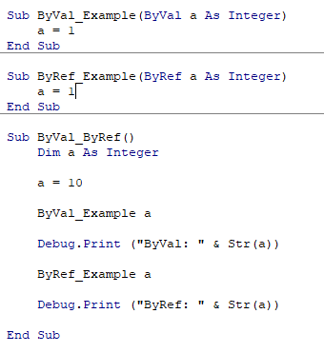

Learning by Doing: VBA Fundamentals
Functions/Methods – ByVal and ByRef Input Parameters
ByVal specifies that an input argument of a Function is passed by value, so that the called Function cannot change the value of a variable underlying the argument. If no modifier is specified, ByVal is the default.
ByRef specifies that an input argument of a Function is passed by reference, so that the called Function can change the value of a variable underlying the argument.
The concept of ByVal (pass input parameter by value) and ByRef (pass input parameter by reference) can seem complicated and it may not be obvious where to use this (for now) but the below example should hopefully illustrate the point. The same keyword can be used for input parameters to a Sub-routine as well as Functions/Methods.
When the ByVal_ByRef() Sub-routine is executed, it will print the following:
When the variable a (initial value is 10) is passed in by value (ByVal) to ‘ByVal_Example’ Sub-routine, the Sub-routine cannot change the value of the variable a to 1 even if it tries to do so.
However, When the variable a (initial value is 10) is passed in by reference (ByRef) to ‘ByRef_Example’ Sub-routine, the Sub-routine can change the value of the variable a to 1 inside the code.

Slide 21
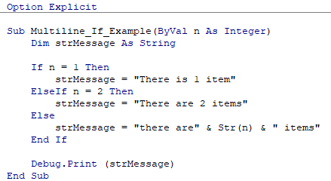
Learning by Doing: VBA Fundamentals
IF statement
If…Then…Else statement conditionally executes a group of statements, depending on the value of a conditional expression. For a single line statements, a single-line syntax can be used per below but multi-line syntax are most commonly used.
For example, please see below a Sub-routine which prints different messages depending on the value of the input parameter.
' Multiline syntax:
If condition_expression hen
[ statements ]
ElseIf elseifcondition _expression Then
[statements ]
Else
[ statements ]
End If
' Single-line syntax:
If condition Then [ statements ] Else [ statements ]

Slide 22
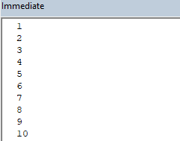
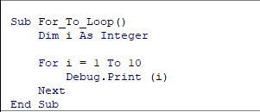

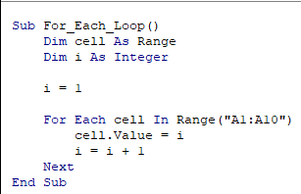
Learning by Doing: VBA Fundamentals
For Loop
Repeats a group of statements a specified number of times. There are two ways of writing a For loop syntax per below:
For…To…Next – Syntax:
Example code and output:
For…Each…Next – Syntax:
Example code and output:
Step is an optional parameter and if omitted default step = 1
For counter = start To end [ Step step ]
[ statements ]
…
[ statements ]
Next [ counter ]
For Each element In group
[ statements ]
…
[ statements ]
Next [ element ]

Slide 23
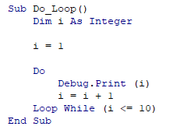
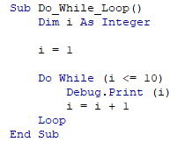
Learning by Doing: VBA Fundamentals
Do…Loop
Repeats a group of statements while a condition is met. There are two ways of writing a Do loop syntax per below:
Do…While…Loop – Syntax:
Example code and output:
Do…Loop…While – Syntax:
Example code and output:
Do While [condition expression]
[statement]
...
[statement]
Loop
Do
[statement]
...
[statement]
Loop While [condition expression]

Slide 24
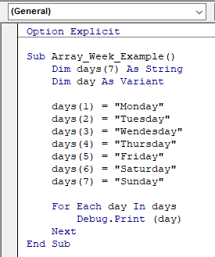
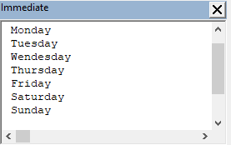
Learning by Doing: VBA Fundamentals
Arrays
Usually, a variable holds one value or has one “compartment” to store a value. For example an integer variable stores one integer value. An array however is a variable that can hold multiple values of the same data type (i.e. has many compartments to store values of the same data type). Arrays could be 1-dimensional (a “list”), 2-dimentional (multiple rows and columns or multi-dimensional. For this course, we will master the 1-dimensional array only and we will cover 2+ dimensional arrays in an advanced course which will follow soon.
Why would we need such a variable? Let’s say that we want to store the name of the days in a week (e.g. Monday, Tuesday, etc). We could create 7 separate variables of type String to store these names but declaring a single array allows us to store all 7 days, where each element in the array will store a day of String type. Pictorially, this can be represented per below and example code and output are shown below.
Array
“Monday”
“Tuesday”
“Wednesday”
…
“Sunday”
Array Declaration Syntax:
Dim name(num_elements) As data_type
Storing values within each element of an Array
Using For Each loop to iterate through all elements in an array and performing an action, in this case, printing to the ‘Immediate Window’.

Slide 25
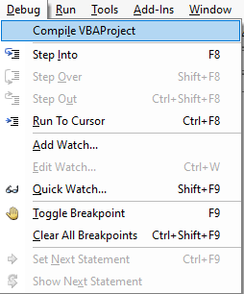
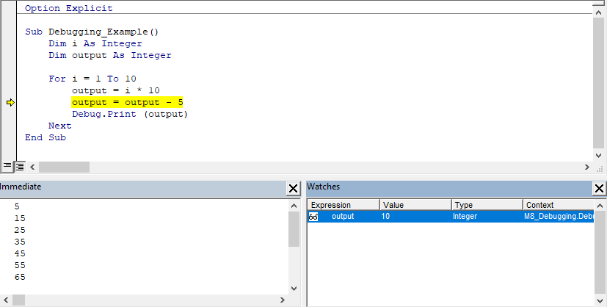
Learning by Doing: VBA Fundamentals
Debugging a VBA program
Debugging is a process of identifying and removing errors or unintended behaviour from your program.
As you start building more complex program in VBA, you will encounter errors/unintended behaviour from your program. The more lines of code you have in your program, the harder it will become to identify errors by just reading through your code only.
Fortunately, the VBA editor comes with a powerful debugging tool, which will help you to step through your code and see outcomes and state of each variables for each line of code. In the VBA editor, the ‘Debug’ menu option holds a series of useful tools for debugging, such as ‘Step Into (F8)’ functionality, which lets us step through each line of code from top to bottom and ‘Watches’ window that can be used to monitor the values of variables throughout the execution of the program.
In the Example workbook’s ‘Debugging’ module, we will go through an example program and use these debugging tools.

Slide 26
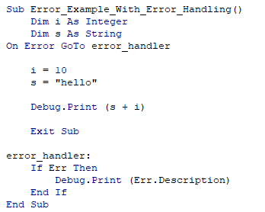
Learning by Doing: VBA Fundamentals
Error Handling: On Error GoTo statement
Error handling means a planned response to error scenarios. This involves a programmer to put in a specific error-handling routines, which will perform a specific action if errors occur during a program execution.
In VBA, there are a number of ways of enabling error handling routines but in this course we will go through an example of one of the commonly “On Error GoTo…” statement.
In the Example workbook’s ‘Error_Handling’ module, we will go through 2 example programs, both with a deliberate error but one Sub-routine without error handling and another Sub-routine with error handling routine.
On Error GoTo error_handler_name
Having this statement at the beginning of the program ensures the program code to jump to the point of code with the ‘error_handler_name’ label, where an error handling routine should be implemented
When an error occurs during program execution, the On Error GoTo statement instructs the VBA interpreter to jump straight to the specified label and any code below the label gets executed. The VBA’s Err object stores details about the error raised during program execution, such as the description of the error, which we are printing out in this example using Err.Description statement.

Slide 27
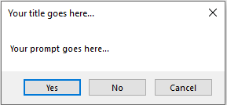
User Interaction
Message Box
MsgBox function can be used to display messages as well as get end user feedback via the buttons. Basic syntax is per below:
Example output and what input arguments change:
Example argument values for the ‘buttons’ input parameter:
Let’s walk through the examples and exercises in the Examples workbook to see how to use ‘MsgBox’ function.
MsgBox (prompt, [ buttons, ] [ title, ] [ helpfile, context ])
prompt
title
buttons
Buttons argument values (examples) | Return Value | Description
vbOKOnly | 0 | Display OK button only.
vbOKCancel | 1 | Display OK and Cancel buttons.
vbAbortRetryIgnore | 2 | Display Abort, Retry, and Ignore buttons.
vbYesNoCancel | 3 | Display Yes, No, and Cancel buttons.
vbYesNo | 4 | Display Yes and No buttons.

Slide 28
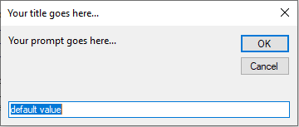
User Interaction
Input Box
InputBox function displays a prompt in a dialog box for end user’s input, which will then be returned as a String output when user clicks the OK button. Basic syntax is per below:
Example output and what input arguments change:
Let’s walk through the examples and exercises in the Examples workbook to see how to use ‘InputBox’ function.
InputBox(prompt, [ title ], [ default ])
prompt
title
default

Slide 29
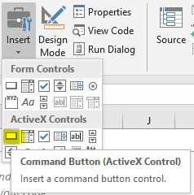
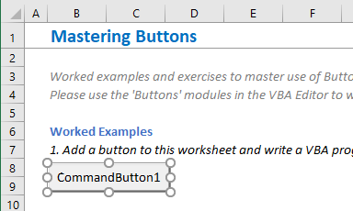
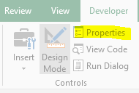
User Interaction
Programming a Button
How to create a button in a spreadsheet?
Developer tab > Insert > Active X Controls’ Command Button
Drag and drop a button in a suitable position in a “target” worksheet. Resize as necessary by dragging.
Keep the Button object highlighted per above (i.e. clicked) and then click on the ‘Properties’ button on the Developer tab

Slide 30
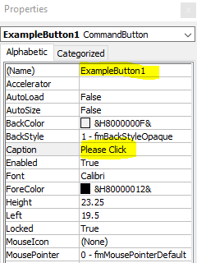
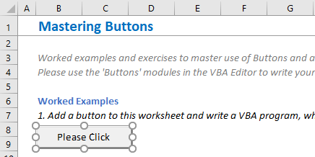
User Interaction
Programming a Button - Continued
The ‘Properties’ window shows all properties of the selected Button, which we can change. For example, let’s change the Button object’s name to ‘ExampleButton1’ and also change the caption (i.e. what gets displayed on the face of the Button) to ‘Please Click’ per below screenshot. When done, close the Properties window.
This will change the button’s caption per below screenshot.

Slide 31
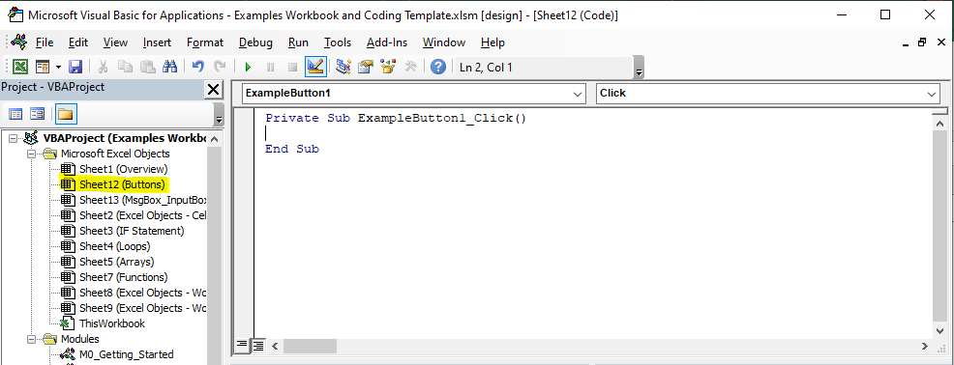

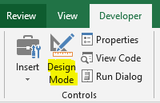
User Interaction
Programming a Button - Continued
Double-click on the button and this will take you to a Sub-routine which gets automatically generated in the VBA editor in the worksheet where you have just created the button (i.e. Sheet12 (Buttons)). This is the Sub-routine, which gets executed when the button gets clicked.
Let’s write a simple code which prompts a MsgBox, when the button is clicked.
To test out the button, go back to the Developer bar and make sure the Design Mode is unclicked per below. When the Design Mode is clicked, Active X controls will not run its assigned VBA code even if clicked.

Slide 32
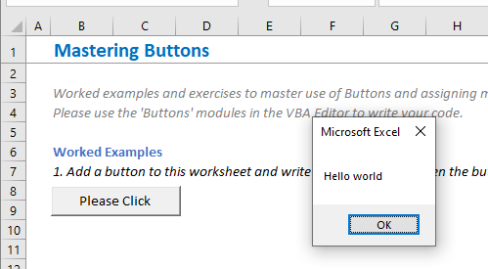
User Interaction
Programming a Button - Continued
Clicking on the Button on the worksheet shows a message box with “Hello world” message as programmed.
In the Example workbook’s ‘Buttons’ module, we will go through examples and exercises to learn more about programming buttons.

